Slide 1
ONLINE RETAIL ANALSYS
By: Rohit Kumar Gupta
Tools Used: Python | Numpy | Pandas | PowerBI
Date: 12th January, 2026

Slide 2
Business Context
A Retail company sells products across multiple countries using an invoice – based transaction system. Sales data is captured at line – item level, including
Quantity and Price
Return
Inventory Adjustments
Promotional/Free Items
Customer Status
Time of Purchase
Management has noticed mismatch in reported revenue and wants clarity on:
Why revenue is not growing despite high order volume.
How returns and adjustments impacts performance?
Which customers are driving real revenue?

Slide 3
Business Problems
Revenue reports look inflated because:
Return transactions are mixed with sales .
Inventory adjustments are included in revenue.
Promotional/Free items distort order value.

Slide 4
Business Questions
Difference between Gross revenue & Net revenue.
What percentage of invoices result in returns?
Are certain products or countries more return prone?
How many invoices represent true customer orders?
Which customers generate high AOV but also high return?
Are repeat customers more profitable than one-time buyers?
How does customer status impact revenue quality.
Which month & days drive peak net revenue?
Are returns clustered around specific times?
Do late hour invoices correlate more adjustments?

Slide 5
Dataset Overview
About Dataset:
The dataset contains 8 columns namely Invoice,StockCode,decription,Quantity,InvoiceDate,Price,customerID, and Country.
This is a large dataset with 1067371 Rows.
There are 34335 duplicate rows in dataset.
There are 0.41% missing values in Description Columns and 22.77% missing values in CustomerID Colum.
There are Negative values in Quantity Column and Price Column.

Slide 6
Data Validation Rules
Validation Rules Applied
Quantity must be greater than 0 for valid sales.
Returns and Inventory adjustments flagged separately.
Promotional/free items flagged separately.
Invoice – level aggregation used for KPIs.
Output
Valid vs Invalid invoices identified.
Cleaned dataset used for KPIs.

Slide 7
Data Cleaning & Transformation
Cleaning Steps: (Tools: Python | Numpy | Pandas)
Removed duplicate rows from the dataset.
Flagged and filtered out bad debt entries from the dataset (with help of Description column).
Flagged rows with negative quantity and 0 prices as Inventory Adjustment.
Flagged rows with negative quantity and prices > 0 as return.
Created a calculated column Revenue by multiplying Quantity and Price.
Created columns InvoiceTime and InvoiceDate from InvoiceDate(Containing Date and Time).
Created ‘Customer Status’ column for identifying customers (Registered or Non-Registered) based on CustomerID column and Inventory Adjustment Column.
Created ‘Promotional/Free’ Column identify Promotional item offered to customers where Quantity > 0 and Price is 0.

Slide 8
KPIs & Metrics
Month on Month revenue growth % (based on current month and previous month revenue)
Year on Year revenue growth % (based on current year and previous year revenue)
Number of Registered and Non-Registered Customers.
Gross Revenue and Net Revenue.(Net revenue = excluding invalid invoices)
Month on Month Return rate (Return Rate = Return Order Count/Total Orders).
Total Orders and Valid Invoices. (Valid invoices = Invoices excluding Inventory Adjustment, Return and Promotional).
Return Invoices
Average Order Value.
Year on Year Customer Acquisition.
Repeating and Non-Repeating Customers.
Order Difference (Current Month and Previous Month)

Slide 9
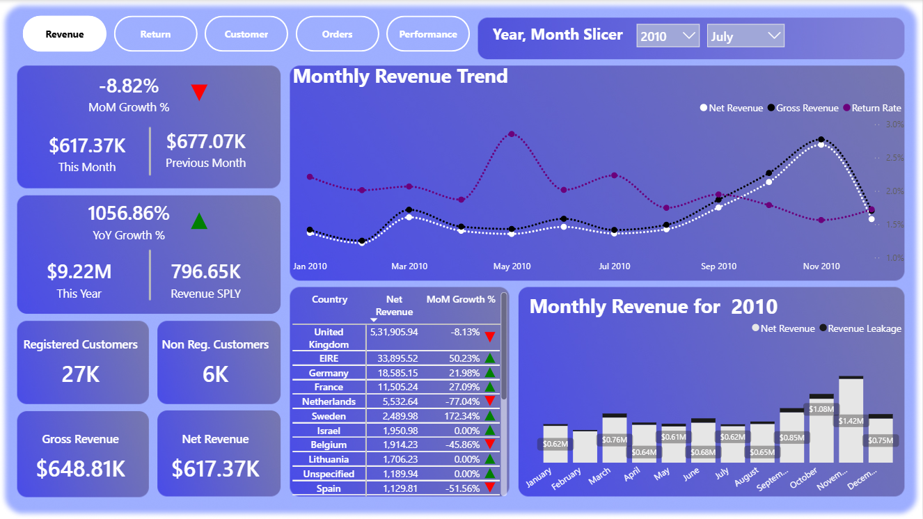
Dashboard Overview
This Dashboard tab helps to analyse the revenue generation of the retail store.
KPIs such as MoM & YoY Revenue Growth along with Monthly revenue trend is used to analyse revenue generation.
Monthly Return Rate Trend is used to analyse return rate.
Country wise Net Revenue With MoM Growth % is used to analyse the country with highest Revenue and/or positive MoM Growth.
Stacked bar chart showing Net Revenue and Revenue Leakage per month for specific year is used to analyze the month for a particular year with highest revenue leakage.

Slide 10
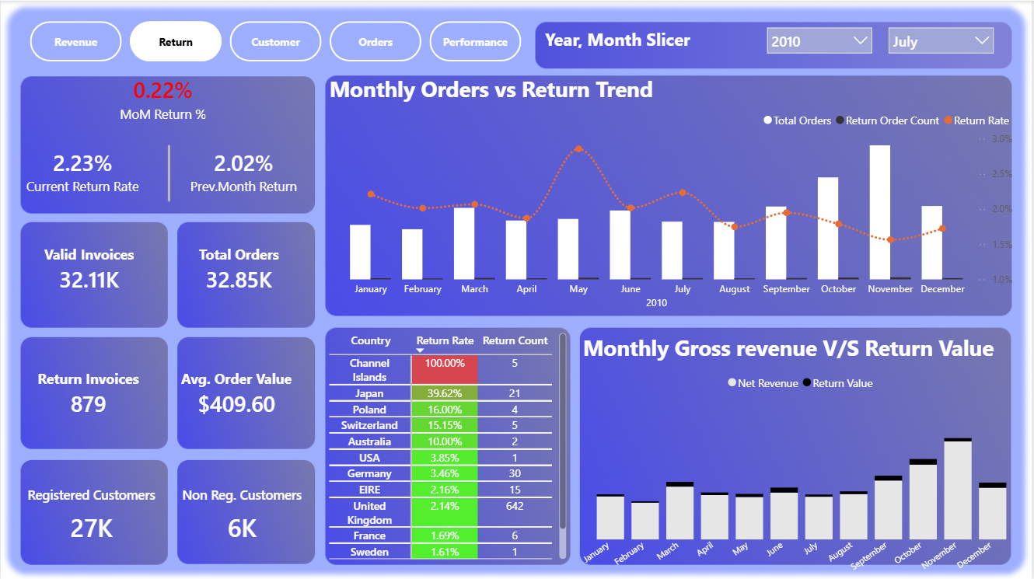
Dashboard Overview
This dashboard tab helps to analyse the return pattern for the retail store.
KPIs such as MoM return % with monthly Trends like Total orders, Return Order Count and Return Rate is used to analyse return pattern w.r.t. to order pattern.
Country wise Return rate and Return Value is used to analyse Return pattern for each country.
Stack bar chart showing monthly revenue v/s return value, which helps analysing revenue lost due to returns per month.

Slide 11
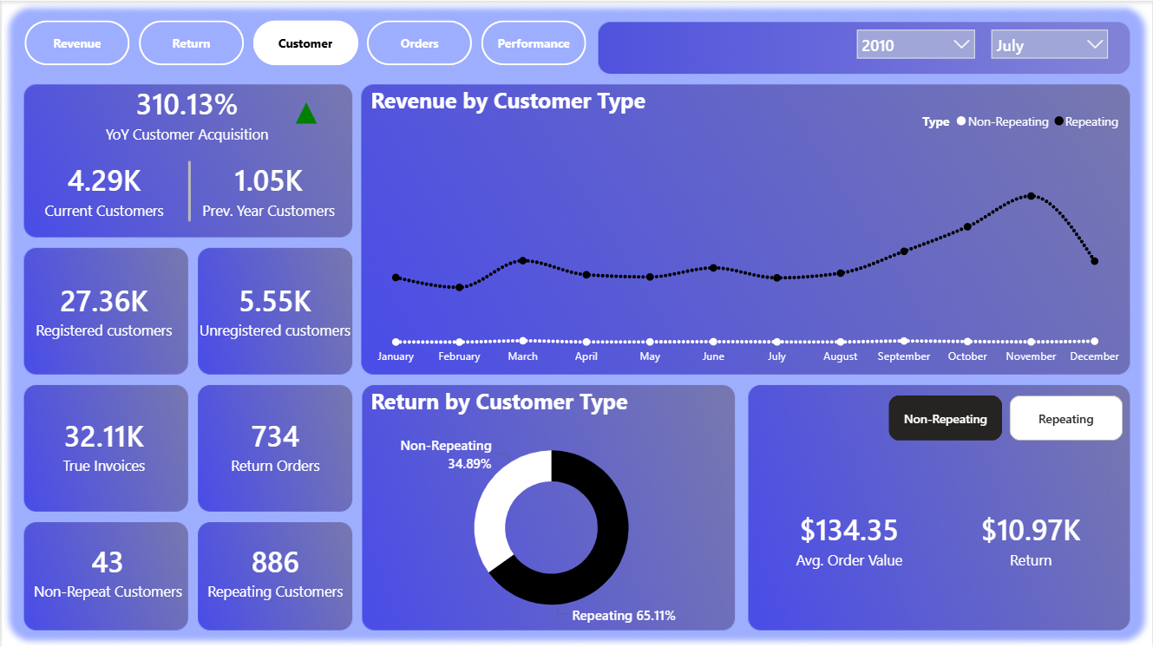
Dashboard Overview
This tab helps to analyse the customer buying/Return behaviour by Customer Type(Repeating or Non-Repeating).
KPIs such as YoY Customer Acquistion, Registered and Unregistered customers is used.
Revenue Trend Chart showing Monthly revenue trend by customer type (Repeat / Non-Repeat) is used.
Return by Customer Type (donut chart) shows the Return value contribution per customer type (Repeating & Non-Repeating).
Average Order value and Returns KPIs shows the corresponding metric by user selected customer type (Repeating / Non-repeating).

Slide 12
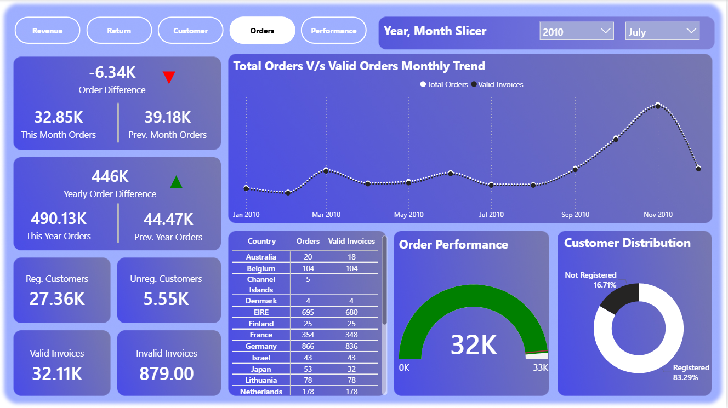
Dashboard Overview
This tab helps to analyse order frequency and order pattern (Country Wise and Customer Wise).
KPIs such as Order Difference and YoY order difference is used to analyse order growth status over time.
Monthly trend of Total Orders vs Valid Orders is used to analyse gaps in order frequency.
Table chart for visualizing Order vs valid Invoices per country is used.
Order Performance gauge is used to show order performance per year per month.
Donut chart showing order count by Customer status (registered, non-registered) is used to show which customers(registered or non-registered) contribute most in order count.

Slide 13
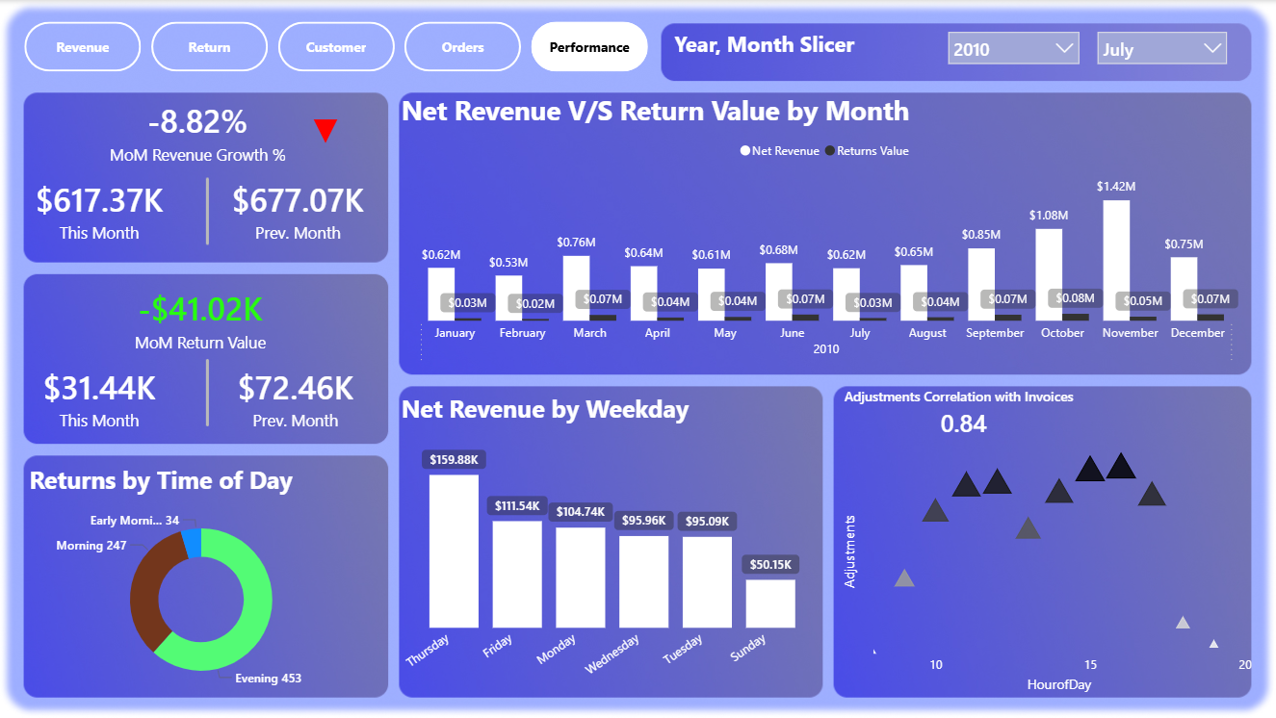
Dashboard Overview
This tab shows the Revenue & return Performance Metric for selected year and month.
KPIs such as MoM Revenue Growth % and MoM return value is used.
Clustered column chart showing Net revenue vs Return by month.
Donut chart showing Return counts by time of the day(Morning, Noon etc). Mostly used to analyse return trend by time of the day.
Column chart showing Net Revenue by Weekday.
Scatter chart showing relationship between adjustment count and hour of the day.

Slide 14
Key Insights
Gross Revenue is always greater than the Net Revenue, showing that there are some negative revenue and zero revenue that can result from return and promotional items.
About 1.86% of invoices resulted in returns.
USA, Japan and Czech Republic are more prone to returns.
1.01Million invoices represent true customer order. 19.103K represent return order.
Repeating Customers not only generates high AOV but also high returns.
Repeated customers are more profitable than One-Time Buyers.
Registered Customers contribute more than unregistered customers.
On an average Thursdays and Tuesdays drive peak net revenue.
September, October and November drive peak net revenue.
Generally “Evenings” is high return prone.
Late hour invoices correlate with more adjustments.

Slide 15
Recommendations

Slide 16
Reduce Returns & Adjustments
Investigate high return rate from Jan to July to identify causes such as logistic issues or unclear product description.
Improve product information , and return policies clarity to reduce negative invoices.
Analyse revenue leakage (Returns and Adjustments) typically on January and December.
Analyze return reasons carefully to reduce returns in the future. Maintain proper product description to avoid potential returns.
Investigate high return countries (USA,Japan and Czech Republic) to identify causes such as logistic issue or unclear product description or sizing problem.

Slide 17
Optimize Customer Segmentation Strategy
Since repeating customers generate high AOV & high Returns, introduce personalized product recommendation to reduce mismatched purchases.
Encourage unregistered customers to register to the store. Assist them with coupons and discounts if possible.

Slide 18
Revenue & Profit Maximization
Focus on seasonal marketing & promotions from September to November, as these months drive peak net revenue.
Run targeted campaign on Thursdays and Tuesdays.
Focus on customer retention strategies on repeating customers as they are more profitable.

Slide 19
Operational Improvement
Monitor late hour invoices , as it correlates with high adjustments.
Schedule experienced staffs or systems, during evening hours, which are return prone.

Slide 20
Conclusion
The analysis reveals that while the business maintains strong gross revenue, returns and adjustments has notable impact on net revenue. A small but significant portion of invoices (~1.86%) result in returns, with specific countries, time and customer type contributing disproportionately.
Repeating and Registered customers emerge as most valuable segment, as they drive high revenues despite of high returns. Revenue peaks during specific Months and Weekdays, indicating clear opportunities to target marketing and conduct campaigns.
By Reducing return drivers, strengthening customer segmentation, and aligning marketing and operations with high performing periods, the business can increase net revenue, improve profitability, improve inventory logistics and customer retention/acquisition.

